Slide 1
STREAMS PROCESSING
IT 301

Slide 2
Topics
What is Streams Processing?
How to Produce Streams
How to Collect Results
How to Transform Streams
How to incorporate Lambda Expressions when processing Streams

Slide 3

19.1 The Stream Concept
Algorithm for counting matches:
List<String> wordList = . . .; long count = 0; for (String w : wordList)
{
if (w.length() > 10) { count++; }
}
With the Java 8 stream library:
Stream<String> words = . . .; long count = words
.filter(w -> w.length() > 10)
.count();
You tell what you want to achieve (Keep the long strings, count them).
You don't dwell on the how (visit each element in turn, if it is long, increment a variable).
"What, not how" is powerful:
Operations can occur in parallel.
The data can be anywhere (e.g. distributed "big data").

Slide 4

Some Facts About Streams
Streams are similar to collections, but... They don't store their own data.
The data comes from elsewhere.
From a collection, a file, a database, data from the internet, ...
Streams were designed to work well with lambda expressions:
stream.filter(w -> w.length() > 10)
Streams are immutable.
Methods such as filter produce new streams.
Stream processing is lazy.

Slide 5
Lazy Processing
Instead of counting the words, let's see some (but not all). Here is how to get the first five:
Stream<String> fiveLongWords = words
.filter(w -> w.length() > 10)
.limit(5);
Bad approach: first generate all long words, and throw most of them away.
Fortunately, stream processing is not bad but lazy.
Works “backwards” and only computes what is necessary.
limit(5) needs an element...
... and filter(....) examines elements until it finds one. That repeats another four times.
And then...nothing.
The other stream elements never get examined.

Slide 6
section_1/StreamDemo.java
import java.io.File;
import java.io.IOException;
import java.util.ArrayList;
import java.util.List;
import java.util.Scanner;
6
7
8
9
10
11
12
13
14
15
16
17
18
19
20
21
22
23
24
25
26
27
28
29
30
31
32
33 }
public class StreamDemo
{
public static void main(String[] args) throws IOException
{
Scanner in = new Scanner(new File("../countries.txt"));
// This file contains one country name per line List wordList = new ArrayList<>();
while (in.hasNextLine()) { wordList.add(in.nextLine()); }
// Now wordList is a list of country names
// Traditional loop for counting the long words long count = 0;
for (String w : wordList)
{
if (w.length() > 10) { count++; }
}
System.out.println("Long words: " + count);
// The same computation with streams count = wordList.stream()
.filter(w -> w.length() > 10)
.count();
System.out.println("Long words: " + count);
}

Slide 7
Program Run:
Long words: 63
Long words: 63

Slide 8
Learning Practice
Complete the 5 Self-Check Exercises at the end of Section 19.1 The Stream Concepts in the Big Java interactive textbook at
https://bookshelf.vitalsource.com

Slide 9

19.2 Producing Streams
In order to process streams, you first need to have one. Simplest way: the of method:
Stream<String> words = Stream.of("Mary", "had", "a", "little", "lamb"); Stream<Integer> digits = Stream.of(3, 1, 4, 1, 5, 9);
Also works for arrays:
Integer[] digitArray = { 3, 1, 4, 1, 5, 9 }; Stream<Integer> digitStream = Stream.of(digitArray);
This is a stream of Integer objects.
You'll see later how to make a stream of int.
Any collection can be turned into a stream:
List<String> wordList = new ArrayList<>();
// Populate wordList
Stream<String> words = wordList.stream();

Slide 10
Producing Streams
Several utility methods yield streams:
String filename = . . .;
try (Stream<String> lineStream = Files.lines(Paths.get(filename)))
{
...
} // File is closed here
You can make infinite streams:
Stream<Integer> integers = Stream.iterate(0, n -> n + 1);
You can turn any stream into a parallel stream.
Operations such as filter and count run in parallel, each processor working on chunks of the data.
Stream<String> parStream = lineStream.parallel();

Slide 11
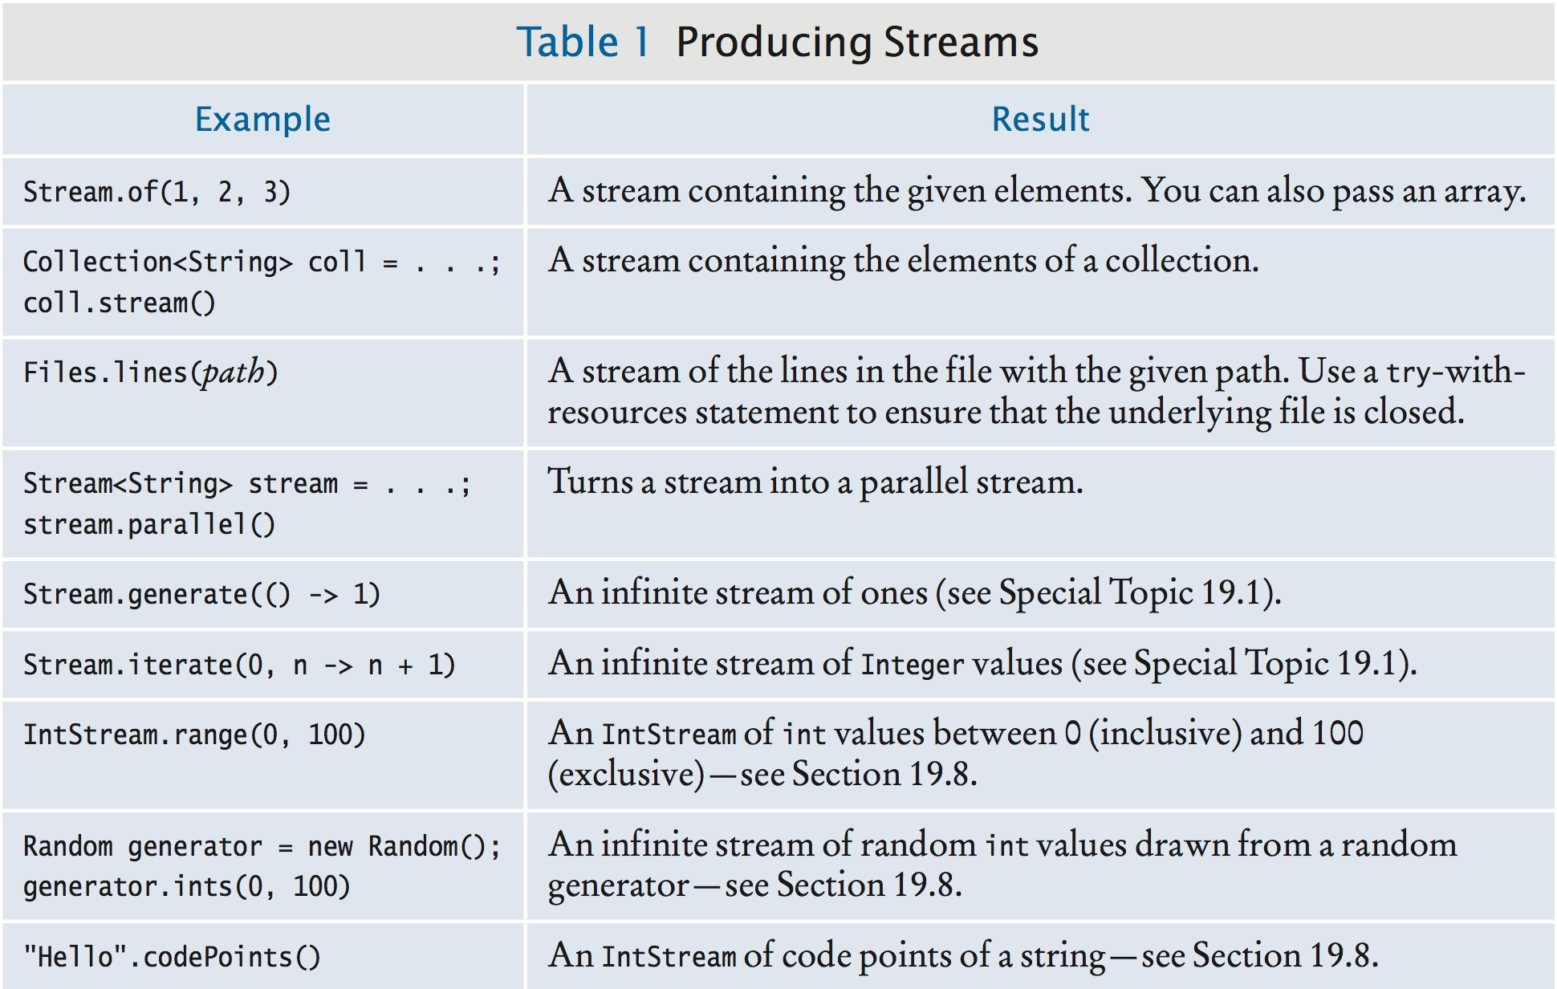
Producing Streams

Slide 12
Producing Streams Problem 1
Write a statement to create a stream of Color objects.
Answer: For example,
Stream<Color> colors = Stream.of( Color.RED, Color.WHITE, Color.BLUE);

Slide 13
Learning Practice
Complete the 5 Self-Check Exercises at the end of Section 19.2 Producing Streams in the Big Java interactive textbook at
https://bookshelf.vitalsource.com

Slide 14

Collecting Results
When you are done transforming a stream (e.g. with
filter), want to harvest results.
Some methods (e.g. count, sum) yield a single value. Other methods yield a collection.
Here is how to collect into an array:
String[] result = stream.toArray(String[]::new);
Strange-looking expression String[]::new is a constructor reference (to the array constructor).
Replace String with another class if the stream doesn't contain strings.

Slide 15
Collecting Results
To collect into a List or Set, use collect:
List<String> result = stream.collect(Collectors.toList()); Set<String> result = stream.collect(Collectors.toSet());
The argument to collect is a Collector object.
We'll always use one of the static method of Collectors to get one.
A stream of string can be collected into a single string:
String result = words.collect(Collectors.joining(", "));
// Stream elements separated with commas

Slide 16
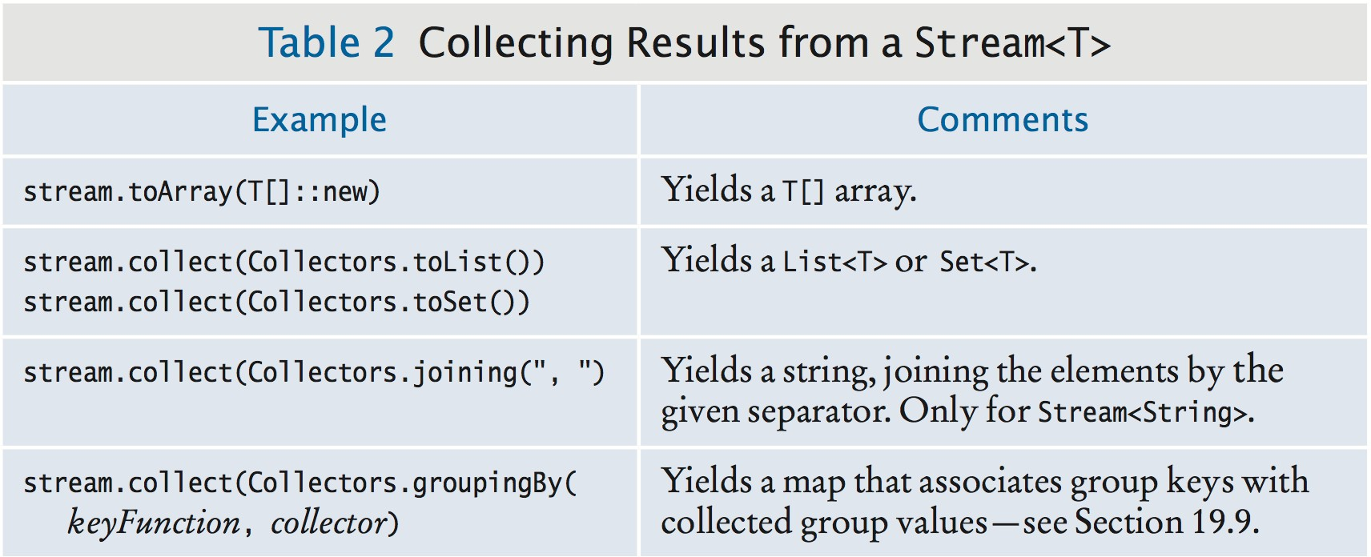
Collecting Results

Slide 17
Self Check 19.12
Repeat Self Check 11, but collect the result in a set.
Answer:
Set<String> result = list.stream()
.filter(w -> w.length() > 10)
.collect(Collectors.toSet());

Slide 18
Tip: One Stream Operation Per Line
It's best to put one stream operation per line:
List<String> result = list.stream() // Create the stream
.filter(w -> w.length() > 10) // Keep long strings
.limit(50) // Keep only the first fifty.
.collect(Collectors.toList()); // Turn into a list
If you cram as much as possible into one line, it is tedious to figure out the steps:
List<String> result = list.stream().filter(w -> w.length() > 10).limit(50)
.collect(Collectors.toList()); // Don’t use this formatting style

Slide 19
Learning Practice
Complete the 5 Self-Check Exercises at the end of Section 19.3 Collecting Results in the Big Java interactive textbook at
https://bookshelf.vitalsource.com

Slide 20

Stream Tranformations
Life cycle of a stream:
Create stream.
Transform stream (possibly multiple times). Collect results.

Slide 21
Stream Tranformations - map
map transforms stream by applying function to each element.
Turn all words into lowercase:
Stream<String> words = Stream.of("A", "Tale", "of", "Two", "Cities"); Stream<String> lowerCaseWords = words.map(w -> w.toLowerCase());
// "a", "tale", "of", "two", "cities"
Remove vowels from all words:
Stream<String> consonantsOnly = lowerCaseWords.map( w -> w.replaceAll("[aeiou]", ""));
// "", "tl", "f", "tw", "cts"
Get the length of each element:
Stream<Integer> consonantCount = consonantsOnly.map(w -> w.length());
// 0, 2, 1, 2, 3

Slide 22
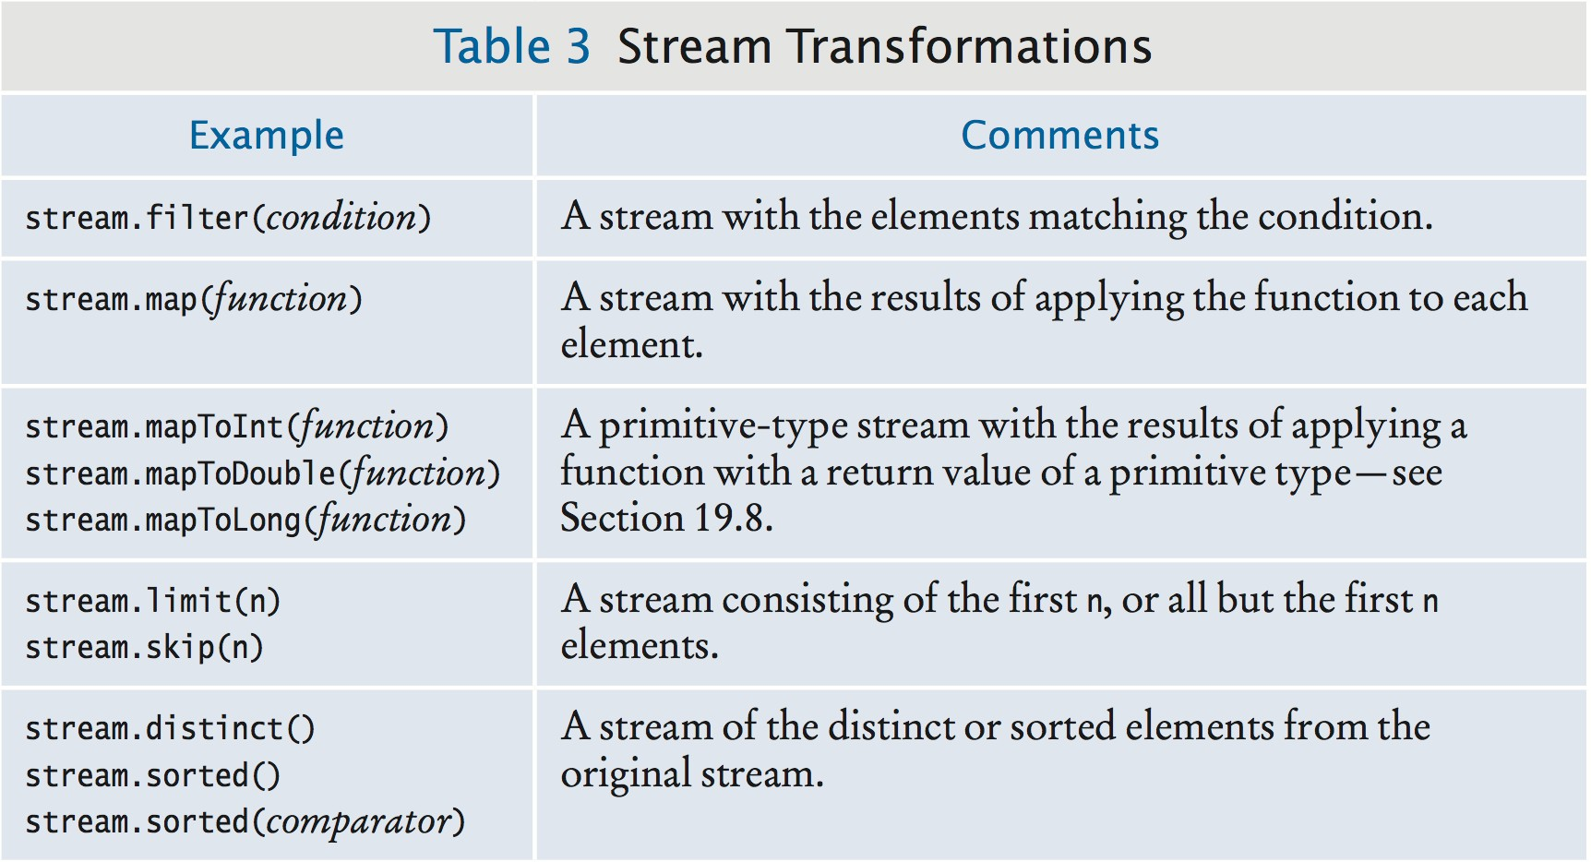
Stream Transformations - Table of Examples

Slide 23
More Stream Transformations
Applying map yields a stream with the same number of elements.
filter only retains matching elements:
Stream<String> aWords = words.filter(w -> w.substring(0, 1).equals("a"));
// Only the words starting with "a"
limit takes the first n:
Stream<String> first100aWords = aWords.limit(100);
skip takes all but the first n:
Stream<String> allButFirst100aWords = aWords.skip(100);
distinct yields a stream with duplicates removed:
Stream<String> words = Stream.of(
"how much wood could a wood chuck chuck".split(" ")); Stream<String> distinctWords = words.distinct();
// "how", "much", "wood", "could", "a", "chuck"
sorted yields a new stream in which the elements are

Slide 24
sorted:
Stream<String> sortedWords = distinctWords.sorted();
// "a", "chuck", "could", "how", "much", "wood"
Element type must be Comparable
Or supply a comparator: distinctWords.sorted((s, t) -> s.length() - t.length())

Slide 25
section_4/StreamDemo.java
import java.io.IOException;
import java.nio.file.Files;
import java.nio.file.Paths;
import java.util.List;
import java.util.stream.Collectors;
import java.util.stream.Stream;
7
8
9
10
11
12
13
14
15
16
17
18
19
20
21
22
23
24
public class StreamDemo
{
public static void main(String[] args) throws IOException
{
try (Stream lines = Files.lines(Paths.get("../countries.txt")))
{ // Read the lines List result = lines
.filter(w -> w.length() > 10) // Keep only long words
.map(w -> w.substring(0, 7)) // Truncate to seven characters
.map(w -> w + "...") // Add ellipses
.distinct() // Remove duplicates
.limit(20) // Keep only the first twenty
.collect(Collectors.toList()); // Collect into a list System.out.println(result);
}
}
}
Program Run:
[Afghani..., America..., Antigua..., Bahamas..., Bosnia ...,
British..., Burkina..., Cayman ..., Central..., Christm...,
Cocos (..., Congo, ..., Cook Is..., Cote d’..., Czech R...,
Dominic..., El Salv..., Equator..., Falklan..., Faroe I...]

Slide 26
Common Error: Don't Use a Terminated Stream
Once you apply a terminal operation, a stream is “used up”. Can no longer apply any stream operations.
Easy mistake if you have a reference to an intermediate stream:
Stream<String> stream = list.stream();
List<String> result1 = stream.limit(50).collect(Collectors.toList());
// Save the first fifty stream = stream.skip(50);
// Error—the stream can no longer be used
To avoid the error, use “pipeline notation”:
result = create(...)
.transform1(...)
.transform2(...)
.terminalOperation(...)
If you want to do what the example tried to do, you need two streams:

Slide 27
List<String> result1 = list.stream()
.limit(50)
.collect(Collectors.toList()); // This stream can no longer be used List<String> result2 = list.stream() // Create another stream
.skip(50)
.limit(50)
.collect(Collectors.toList());

Slide 28
Learning Practice
Complete the 5 Self-Check Exercises at the end of Section 19.4 Transforming Streams in the Big Java interactive textbook at
https://bookshelf.vitalsource.com

Slide 29
19.5 Lambda Expressions
Have seen lambda expressions in filter and map
methods such as:
w -> w.length() > 10
Like a static function.
Left side of -> operator is a parameter variable.
Right side is code to operate on the parameter and compute a result.
When used with a type like Stream<String>, compiler can determine type.
Otherwise, you can specify the type, like:
(String w) -> w.length() > 10
Multiple parameters are enclosed in parentheses:
(v, w) -> v.length() - w.length()

Slide 30
This expression can be used with the sorted method in the
Stream class to sort strings by length:
Stream<String> sortedWords = distinctWords.sorted( (v, w) -> v.length() - w.length());
// "a", "how", "much", "wood", "could", "chuck"

Slide 31
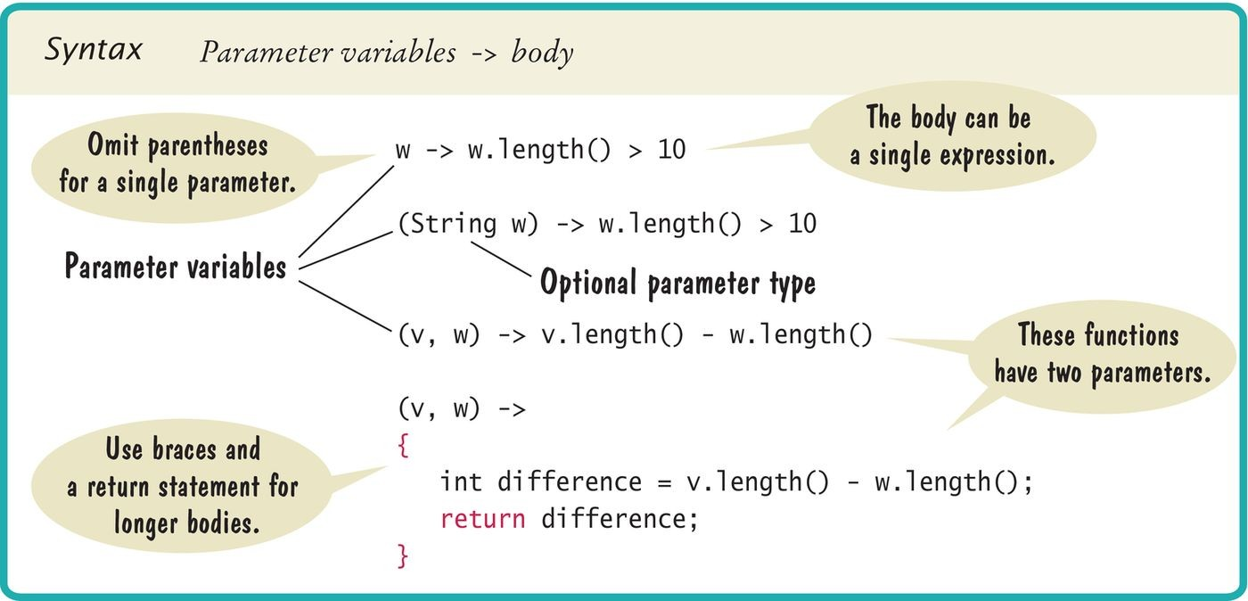
Syntax 19.1 Lambda Expressions

Slide 32
Method Expressions
Common to have lambda expressions that just invoke a method.
Use method expression: ClassName::methodName:
String::toUpperCase
Parameters are added “at the right places”:
(String w) -> w.toUpperCase()
If method has a parameter, the lambda expression gets two parameters:
String::compareTo
is the same as:
(String s, String t) -> s.compareTo(t)
Also works with static methods:
Double::compare

Slide 33
is the same as:
(double x, double y) -> Double.compare(x, y)
Can have an object to the left of :: symbol:
System.out::println
is the same as:
x -> System.out.println(x)

Slide 34
Constructor Expressions
Like method expression, with special method name new. For example,
is equivalent to a lambda expression that invokes the
BankAccount constructor.
Which constructor?
Depends on context—could be:
BankAccount::new
() -> new BankAccount()
or:
b -> new BankAccount(b)
Constructor expressions can construct arrays:
String[]::new
Same as:

Slide 35
Used to overcome limitation of Java generics—can't construct array of generic type.
(n: int) -> new String[n]

Slide 36
Learning Practice
Complete the 4 Self-Check Exercises at the end of Section 19.5 Lambda Expressions in the Big Java interactive textbook at
https://bookshelf.vitalsource.com

